Slide 1
Assessment tool for Elderly Population Cybersecurity Awareness
Feb. 2025

Slide 2
Background and Challenges
Solutions
Assessment Tools
Training on Elderly Communities
A smart home design
A healthy community
Assessment tools example
List of Topics
Timeline and Milestones
Board Impacts/Societal benefits
Assessment tool for Elderly Population Cybersecurity Awareness

Slide 3
Background and Challenges
Solutions
Assessment Tools
Training on Elderly Communities
A smart home design
A healthy community
Assessment tools example
List of Topics
Timeline and Milestones
Board Impacts/Societal benefits
Assessment tool for Elderly Population Cybersecurity Awareness

Slide 4
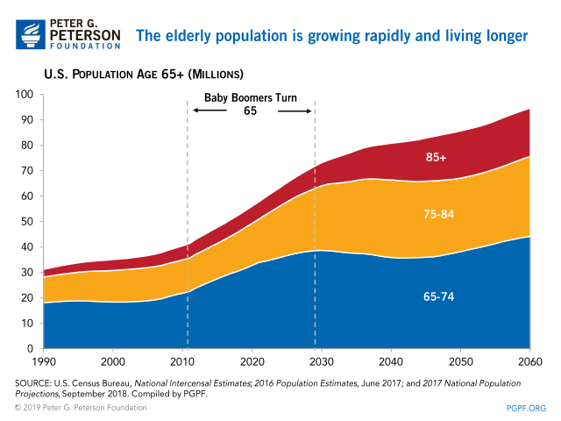
Elderly Population Increasing Rapidly Around the World
By 2030, 1 in 6 people in the world will be aged 60 years or over
The United Nations (UN) General Assembly declared 2021–2030 the UN Decade of Healthy Ageing and asked WHO to lead the implementation.
The number of Americans ages 65 and older is projected to increase from 58 million in 2022 to 82 million by 2050 (a 47% increase)
There are 18,810 Retirement Communities businesses in the US as of 2023, an increase of 0.8% from 2022.

Slide 5
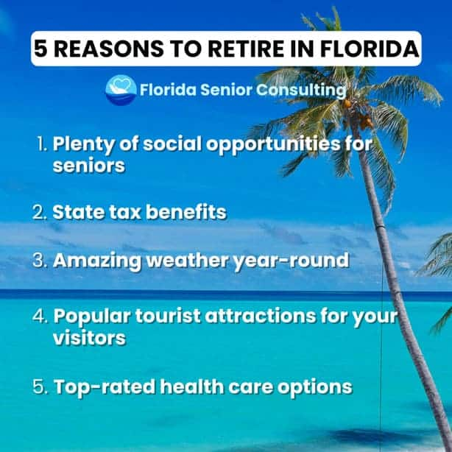
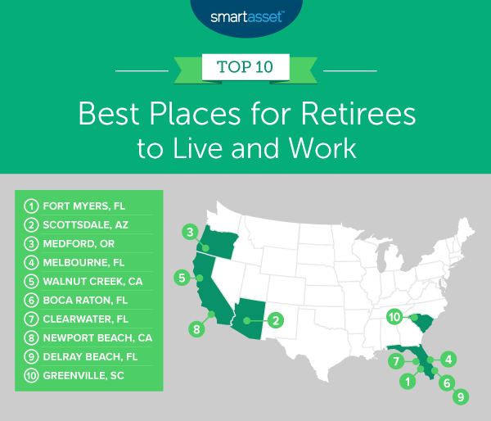
FL (especially in SWFL) – Rich Retirees’ Home
Florida isn't known as a retirement paradise for nothing — it ranks as the best state to retire due to its relatively low taxes for retired people, including no estate, inheritance, or income taxes
For many people, the ideal place to retire encompasses a balanced mix of safety, affordability and healthcare access.

Slide 6
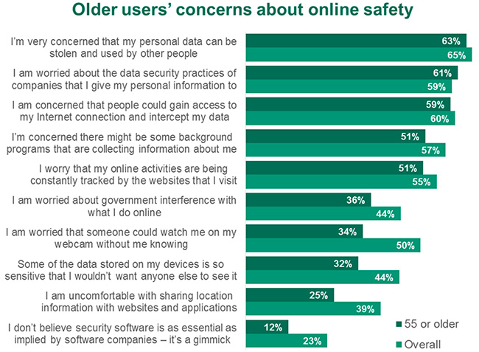
Elderly People Easy to get Cyber Attack!
Increasingly older Americans use the Internet to get involved in community groups, shop, plan travel, manage finances, and keep in touch with family and friends
Only 26% of senior internet users feel “very confident” when using computers and smartphones
Senior citizens lost $1.7 billion as victims of online crime in 2021, and the U.S. has seen a 400% increase in internet crime toward this age group in the past five years.

Slide 7
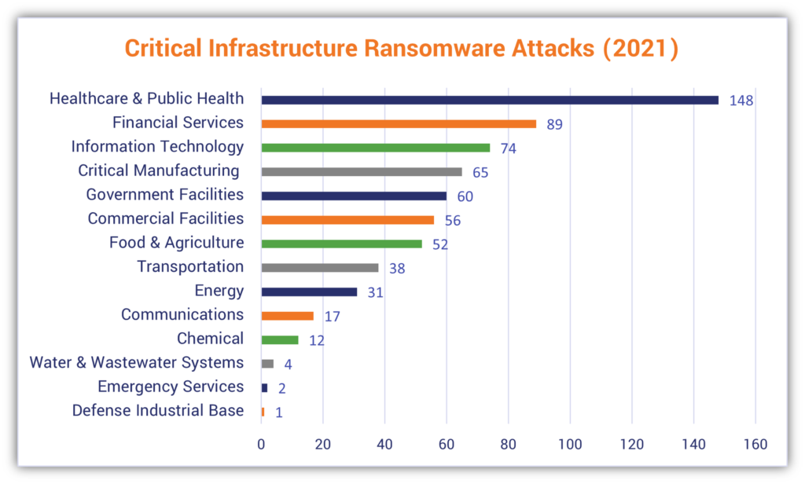
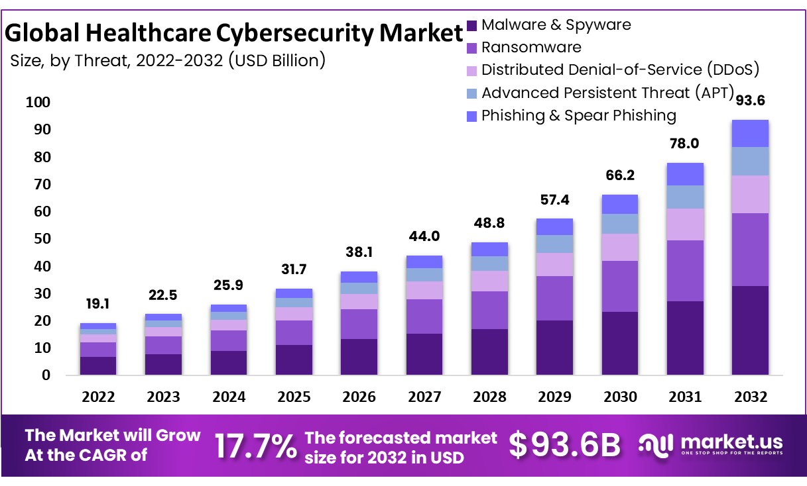
Elderly Healthcare is also a Target by Hackers

Slide 8
Challenges on Elderly Population Cybersecurity Awareness
They don’t know the current cybersecurity attacks.
They’re afraid of learning network/smart phone techniques.
They usually are rich, and each to be a target for hackers.
Living space is not safe as well, no smart home designs.
Healthcare information is sensitive and each to access.

Slide 9
Background and Challenges
Solutions
Assessment Tools
Training on Elderly Communities
A smart home design
A healthy community
Assessment tools example
List of Topics
Timeline and Milestones
Board Impacts/Societal benefits
Assessment tool for Elderly Population Cybersecurity Awareness

Slide 10
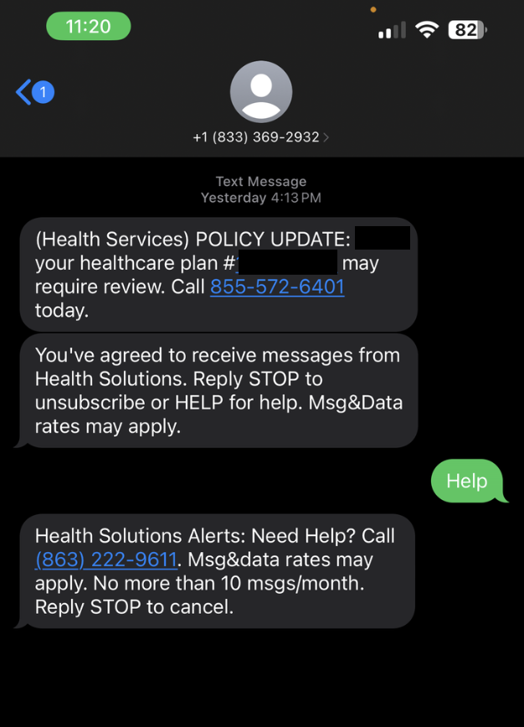
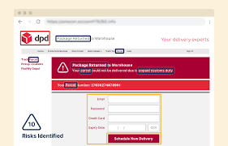
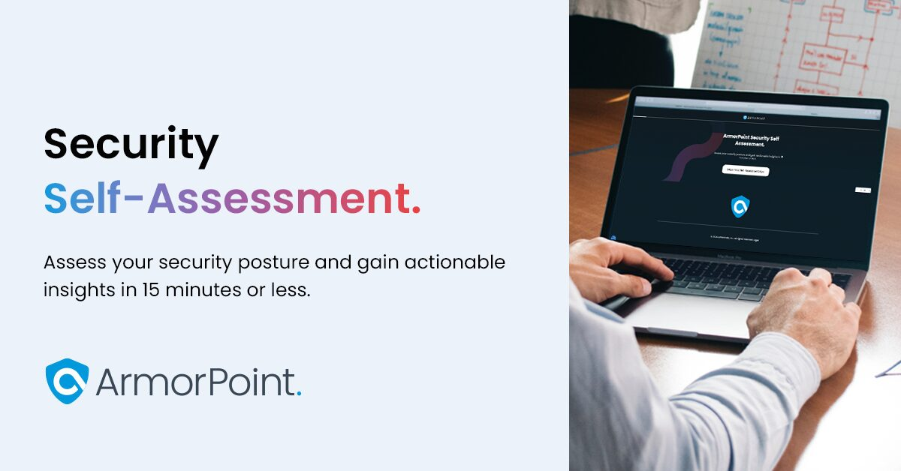
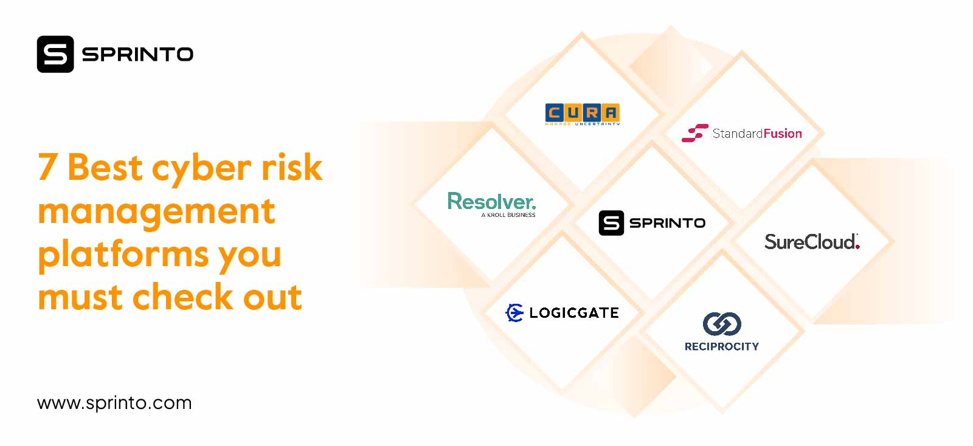
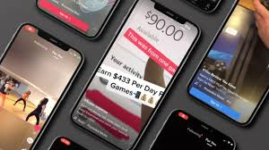
Target of this project
Build a cross-platform assessment tool/software for
elderly population groups and senior communities

Slide 11
Background and Challenges
Solutions
Assessment Tools
Training on Elderly Communities
A smart home design
A healthy community
Assessment tools example
List of Topics
Timeline and Milestones
Board Impacts/Societal benefits
Assessment tool for Elderly Population Cybersecurity Awareness

Slide 12
Phish Finders – An assessment tool for phish websites
https://www.zooniverse.org/projects/holliekrosser/phish-finders

Slide 13
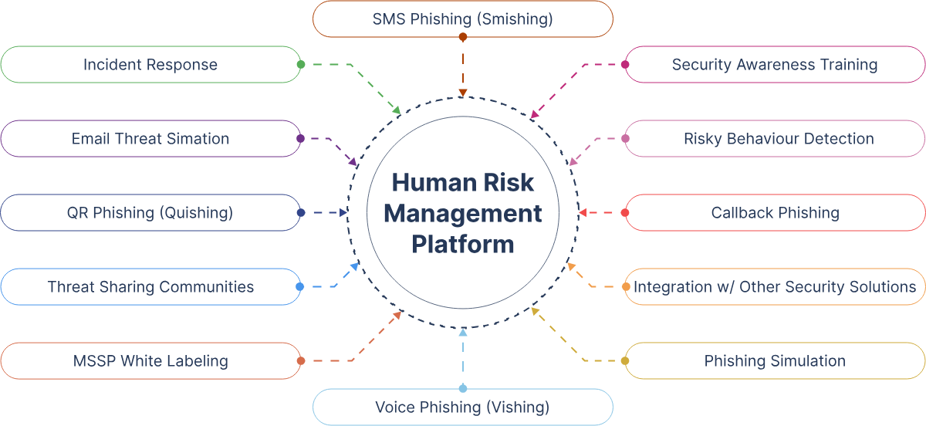
Vishing Simulator – A Commercial Product

Slide 14
Background and Challenges
Solutions
Assessment Tools
Training on Elderly Communities
A smart home design
A healthy community
Assessment tools example
List of Topics
Timeline and Milestones
Board Impacts/Societal benefits
Assessment tool for Elderly Population Cybersecurity Awareness

Slide 15
In your cross-platform assessment tool, you must have
Cross platform features, run on laptop and on your phone, can be web-based and/or app-based
Operation friendly, e.g., larger font, each to operate, less click, fast tutorial, quick response, etc.
Match elder communities activities and three categories: phishing, smishing and vishing.
Both front-end and back-end, with database to save assessment results.
A secure platform! Think about security before development!

Slide 16
Topics – design your app with all below
Phishing assessment on social engineering
Website, Apps (TikTok,News), and SMS
Phone scams assessments
Fake phone calls, ransom calls, voice changer
Video calls assessments
Deepfake videos, Facetime videos, network problem videos
Advertisements
Website ads mistakenly touch, redirect, XSS attack on website, physical ads
Other Cybersecurity related topics that worth to assess

Slide 17
Background and Challenges
Solutions
Assessment Tools
Training on Elderly Communities
A smart home design
A healthy community
Assessment tools example
List of Topics
Timeline and Milestones
Board Impacts/Societal benefits
Assessment tool for Elderly Population Cybersecurity Awareness

Slide 18
No mentor!
Pure Software development!

Slide 19
You have freedom on this project!
Find examples on cybersecurity risks and attacks.
Apply features on your app targeting elderly population.
Open-source, cross-platform application.
A full-stack development experience.
Security-oriented development rather than objective-oriented development.

Slide 20
Timeline – Same for all projects
Milestone 1: February 25th , each group should provide a research plan document detailing the tasks for each team member in the group.
Milestone 2: March 18th and March 20th , mid-term evaluation presentation. Each group should present their process so far and plans for the final output in the class. Mentors can choose to join.
Milestone 3: April 22nd and 24th , final presentation. Each group should present their final outputs to the class. Peer evaluation will be given by professors and students. Mentors should join in the presentation and present together with students.
Milestone 4: April 29th , final report. Each group should submit a final report of the project including a comprehensive description of the project method, algorithm/modeling details, and evaluation output. Mentors can guide the writing of the report.

Slide 21

To generate a software development team
Team leader – Project Manager
UI/UX designer
Front-end developer
Back-end developer
Tester/Security Analyst
What is your role?

Slide 22
Assessment tool for Elderly Population Cybersecurity Awareness
Build your team today!

